Slide 1
Cognition Fundamentals: Refresher
Block B: Attention, (Visual) Perception and Memory
Responsible Lecturer: Bram Heijligers

Slide 2
What is cognition?
Why is cognitive science relevant?

Slide 3
What will we do today?
Recap of:
Block B
Perception: Visual (& kinaesthetic)
Memory: Learning
Attention: Sampling
Emotion: Learning & motivation/goals setting
---- SHORT BREAK ----
Auditory System
Afternoon:
Use-case walkthrough
Feedback & Q&A

Slide 4
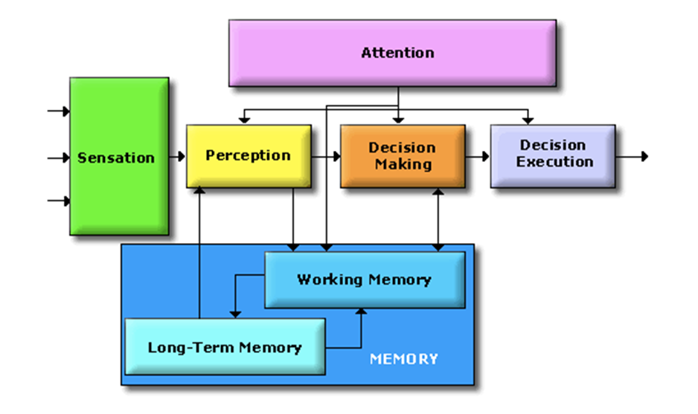
The Cognitive System
Correction!
The long-term memory loads information into the perceptual system
Adverse to the working memory
But as I said last block about memory:
“a term widely used but without much agreement” (Baddeley & Hitch, 1974)
We’ll get back to this
Notes:
On the separate parts:
This approach is taken to aid clarity of explanation, but in so doing, can give the impression that individual aspects of cognition can be understood in isolation from each other. However, it is always important to remember that to properly understand the role of any single aspect of cognition we must appreciate how that role is dependent upon and interacts with other aspects.

Slide 5
Why did we need attention?

Slide 6
The Cognitive System
Cognitive scientists study intelligence and behavior, with a focus on how the nervous systems represent, processes, transforms, stores and recoverers information.
Essentially, information is captured by ‘sensors’
from where it is processed and in different ways:
Like data flowing through an
algorithm!
Key difference is the human minds
limited processing capacity which is
why we need attention! → Selection!
Not actually separate parts; nothing is truely separate, but
classification is how humans deal with information → r.i.p. us
Notes:
On the separate parts:
This approach is taken to aid clarity of explanation, but in so doing, can give the impression that individual aspects of cognition can be understood in isolation from each other. However, it is always important to remember that to properly understand the role of any single aspect of cognition we must appreciate how that role is dependent upon and interacts with other aspects.

Slide 7
How do we perceive?
Using our different senses: (Sherrington’s codification)
Teloreceptive (vision and hearing)
Proprioceptive (limb position)
Exteroceptive (touch)
Chemoreceptive (smell and taste)
Interoceptive (visceral, but based on later findings also includes the sense of the physiological condition of the entire body)
may reflect predictions about the expected state of the body rather than actual sensations (Barrett & Simmons, 2015)
Auditory: What we’ll cover this block!

Slide 8
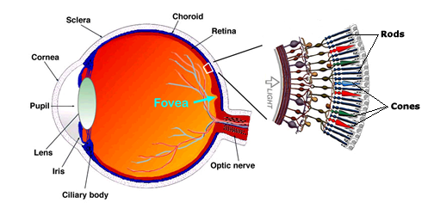
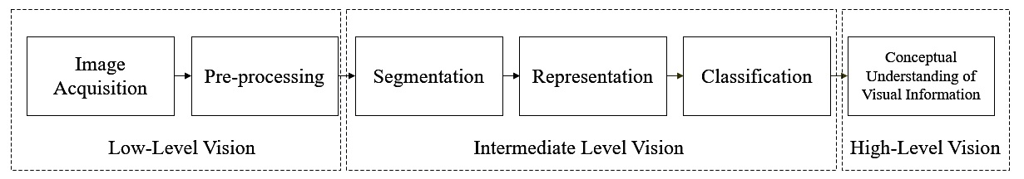
Visual Perception
The information received using the eye is received at a 24 hertz and incomplete; meaning information is missing.
Visual perception uses several processing steps to create a holistic, constant and stable visual experience.
Information is then further segmented, represented, classified (contextualized) and conceptually understood

Slide 9
Visual Attention
Sampling & Prioritizing what we perceive
Cannot take in all visual information at once.
Therefore, shift attention around environment to focus on important sources of information.
‘Spotlight’ metaphor
Attention is like a spotlight which moves about and allows us to selectively attend to parts of the visual world.
Michael Posner (1980) suggested that enhanced processing/detection occurs within this ‘spotlight’.
So attention is directed towards ‘space’ according to the spotlight model. It is a space-based model of attention.

Slide 10
Attention
Windows task manager for humans
Attention is how the brain controls its own information processing
Can be measured through conscious introspection, overt and implicit behaviors, electrophysiology and brain imaging
External attention – selection and modulation of sensory information
Selects locations in space, points in time, or modality-specific input
Feature-based or object-based
Integration of objects/features over space, time and modality
Internal attention – selection, modulation and maintenance of internally generated information
High-level cognitive (thoughts, plans, rules & responses, self-monitoring, memories)
Low-level cognitive (bodily functions – pain, hunger, etc.)

Slide 11
Attention
Windows task manager for humans; for our purposes
LIMITED CAPACITY – evolved out of necessity to focus limited processing capacity to the most important information
SELECTION – multiple stimuli compete for selection and the goal is to select the stimulus most relevant to current tasks and goals;
MODULATION – once a stimulus is selected, attention also determines how well it will be processed, how fast and how accurately, and whether it will be later remembered
VIGILANCE – closely related to modulation (which is limited in time and has immediate effects); the ability to sustain attention over extended periods of time

Slide 12
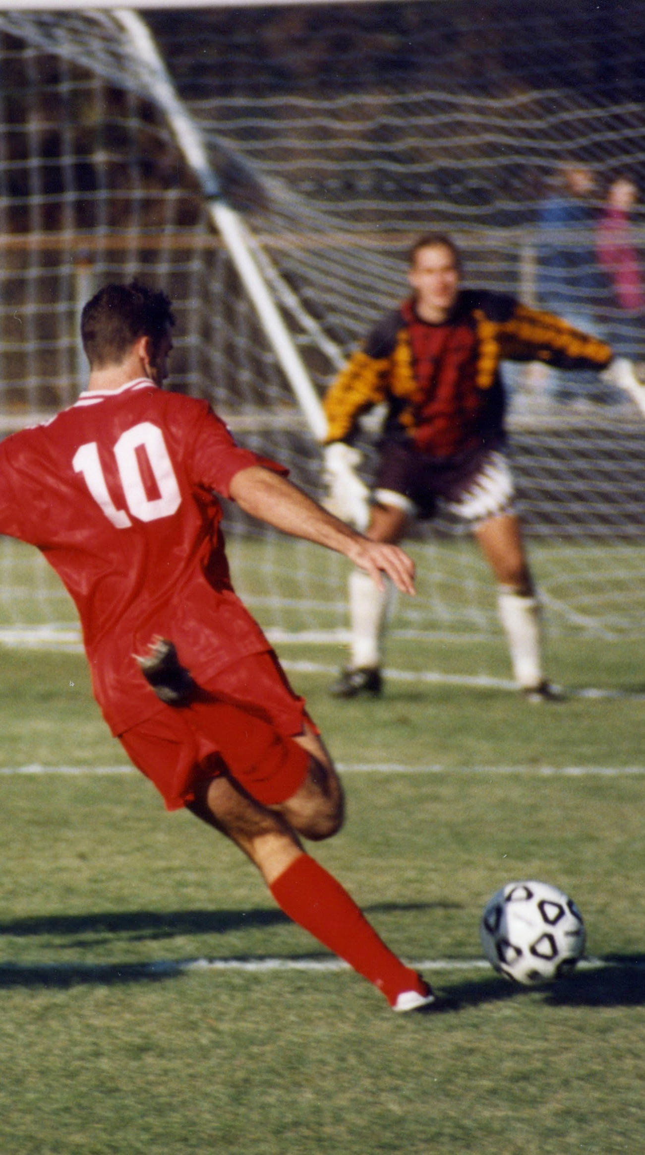
Conscious situational awareness?
“Most of the processing in the brain is not available to conscious inspection” (Styles, p. 6)
Attention
Selection of a subset of information for further processing
Depending on the sensory stimulus (visual, auditory, multisensory…)
Active (controlled by individual’s goals) vs. Passive (controlled by external stimuli) – top-down vs. bottom-up
Focused (selective - sustained) vs. Divided (multitasking)
Internal (internal processes; endogenous) vs. External (external stimuli; exogenous)
Processing resources allocated to perform a cognitive task
Outcome of processing that allows us to process certain input
Control of attention also involves (executive) action…

Slide 13
How do I achieve situational awareness
What input do we need to understand a given situation?
Conscious vs. unconscious information processing (Salti, Harel, & Marti, 2019)
3 factors that influence this process:
Context; what we already made
Conceptual understanding of the individual elements of the environment
Prior-knowledge of relevant/sampled individual elements
Causal relationships between the relevant/sampled individual elements
Stimulus saliency
Observer’s goals

Slide 14
Working Memory
“ a term…used widely, but without much agreement”
A mechanism that keeps a small amount of information that is particularly task-relevant in a privileged state in which it can be accessed easily (Cowan, 2015)
The information can come from recently experienced events or from LTM
Storage an information as well as the manipulation of that information by central executive processes (Baddeley & Hitch, 1974)

Slide 15
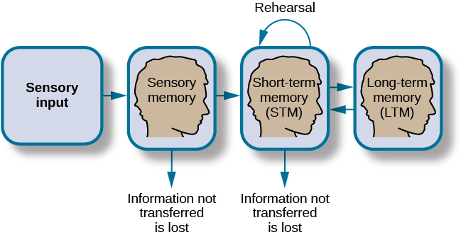
How memory functions

Slide 16
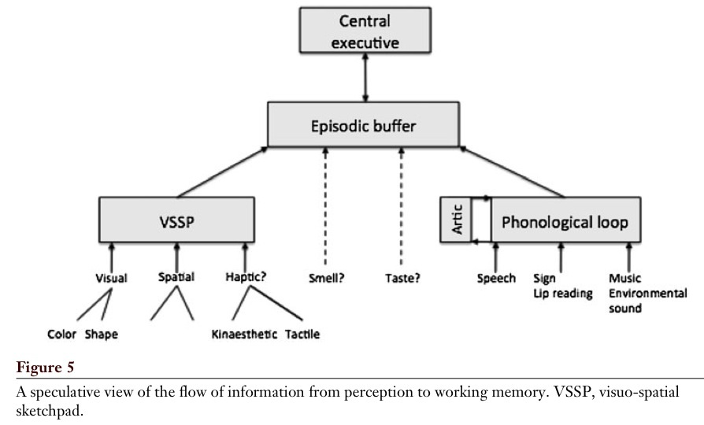
Working Memory for Perception
Baddeley, 2012

Slide 17
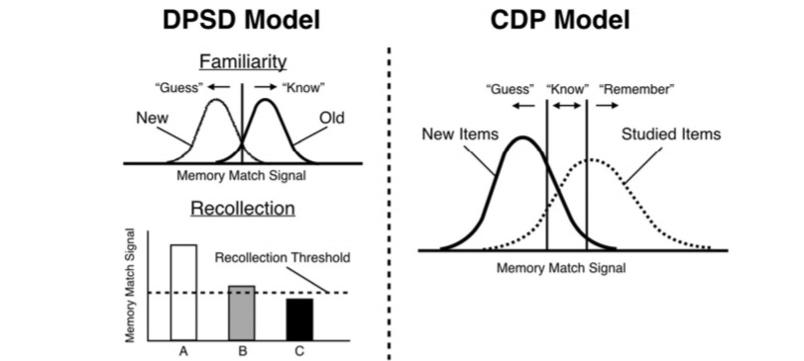
Familiarity vs. Recollection: The DPSD and CDP Models
Notes:
DPSD = dual-process signal-detection
The dual-process signal-detection (DPSD) model assumes that recognition memory is based on recollection of qualitative information or on a signal-detection-based familiarity process.
CDP = continuous dual process
The dual-process theory of recognition memory holds that recognition ‘decisions’ can be based on either recollection or familiarity, and the gues/know/remember procedure is seen as continuous flow and see recollection as a stronger form of familiarity.
What’s important to remember is that the signals stored in the long-term memory is compared to that in the working-memory.

Slide 18
Types of Memory: the brain as a database
Memory
Sensory (< 1 sec)
Working/Short-term (<1 min)
Long-term (< end of days)
Procedural (implicit; skills)
Declarative (explicit; facts)
Episodic
Semantic
Iconic (images)
Echoic (sounds)

Slide 19
Why is motivation important?
Why are rewards central to human behaviour?

Slide 20


Rewards & Motivation
Motivation is what motivates us; lies at the base of intelligence
Reinforcement Learning is learning what to do and how to map situations to actions. The end result is to maximize the numerical reward signal. The learner is not told which action to take, but instead must discover which action will yield the maximum reward.

Slide 21
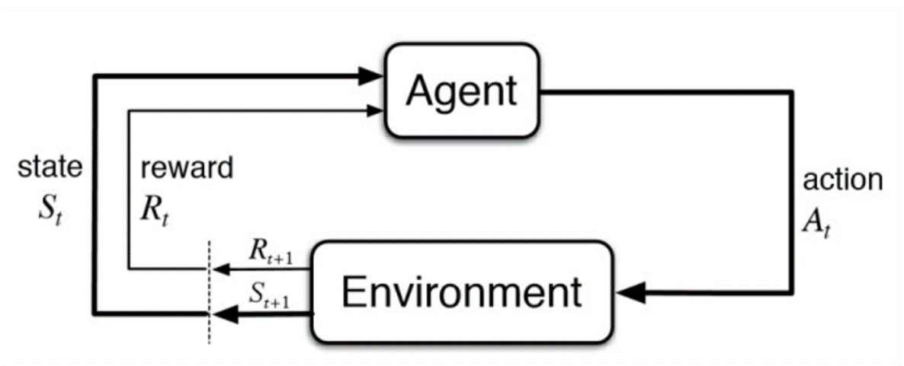
Reinforcement Learning

Slide 22
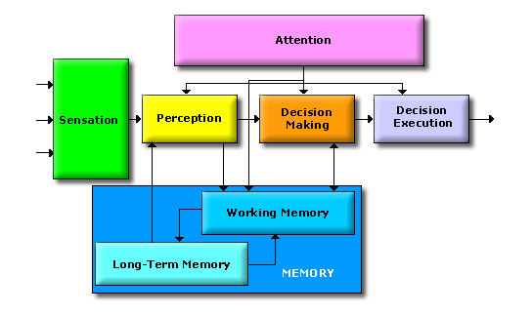
What is decision-making?
Decision-making is the process of making choices by analyzing information and evaluating possible outcomes. This process includes identifying and defining a problem, gathering information, generating solutions, evaluating alternatives, making a choice, and implementing a decision.
Dependent on:
situational awareness;
the (un)certainty of the environment and processes within;
planning & inferences;
agent motivation/goal.

Slide 23
Active Sampling - (Learning)
A type of cognitive strategy in which a person actively engages with their environment in order to acquire new knowledge or information. Can include:
intentional exploration of unfamiliar surroundings;
taking part in activities that provide new experiences;
and actively seeking out new sources of information
Active sampling is seen as a more efficient way for people to learn and acquire new knowledge as it involves actively engaging with the environment rather than passively absorbing information.

Slide 24
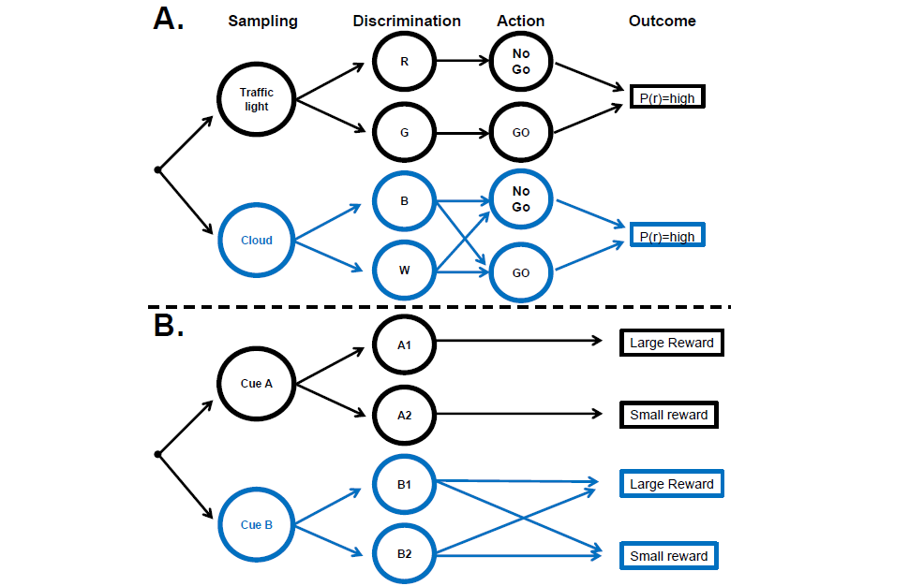
Decision chains for sampling and action
Gottlieb, 2018

Slide 25
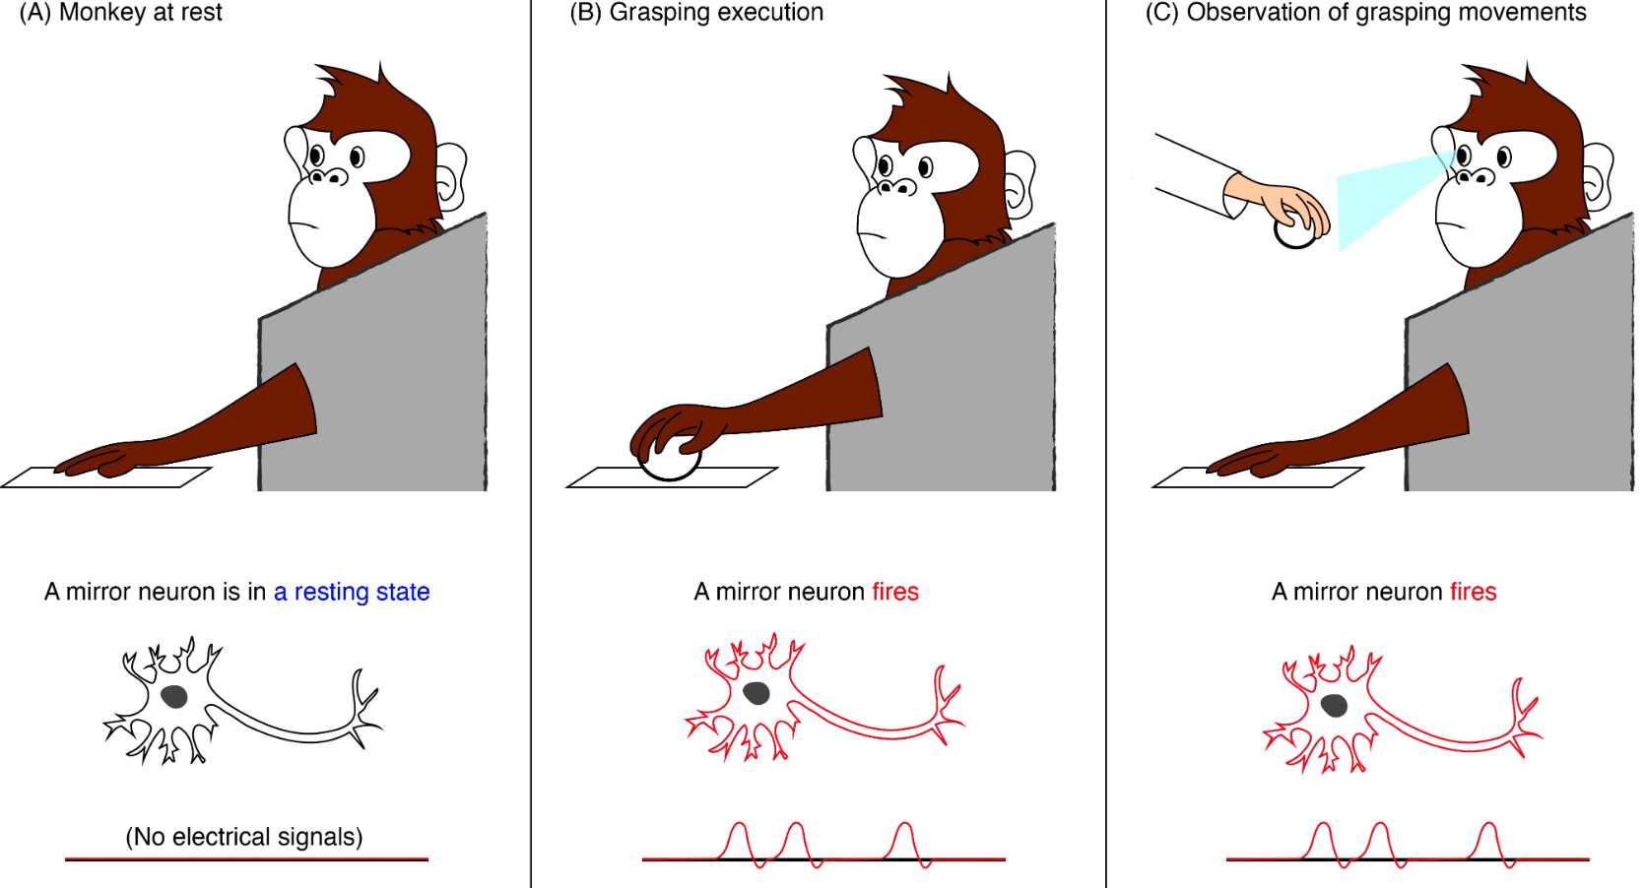
Mirror-Neurons – (learning)

Slide 26
Break
Take a walk of 5 minutes and meet me at the Innovation Square!
Be back in 20 minutes for the perception lecture!

Slide 27
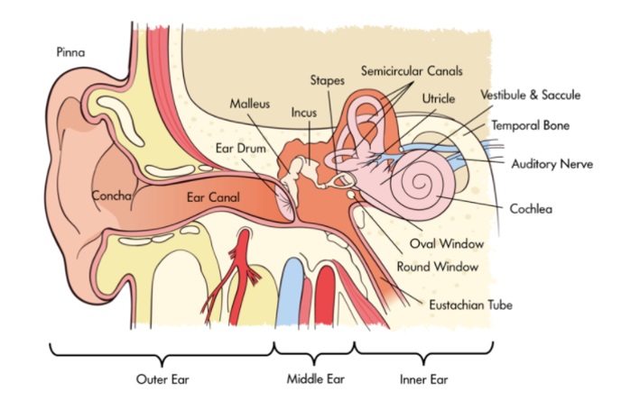
The Human Auditory System

Slide 28
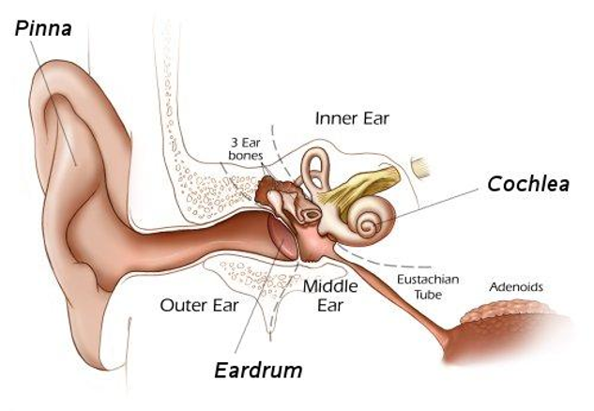
Cochlea

Slide 29
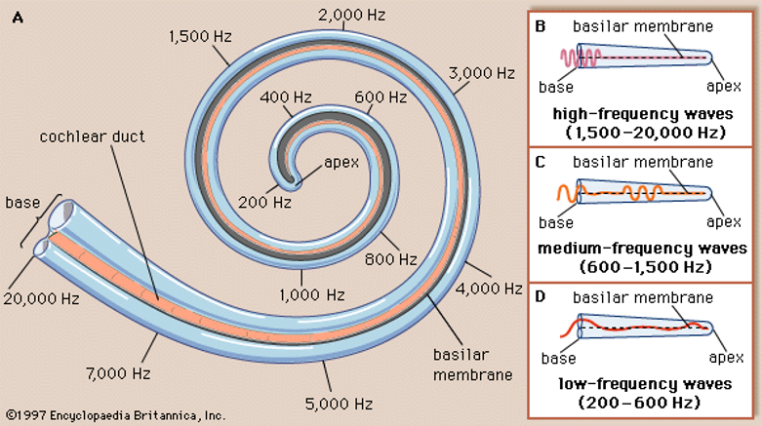
Basilar Tuning

Slide 30
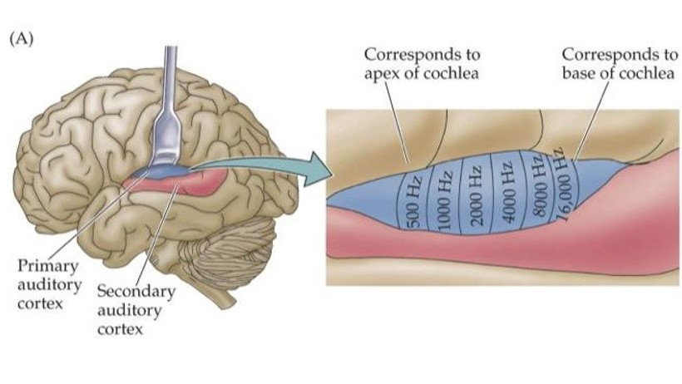
Auditory Cortex

Slide 31
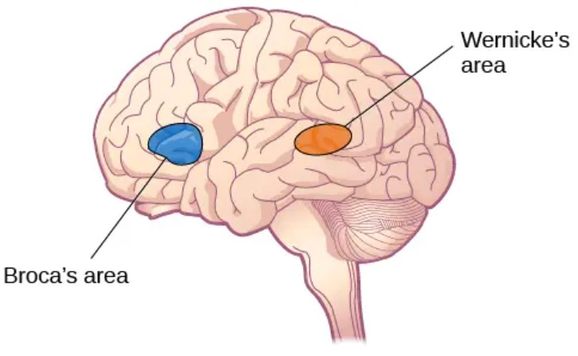
Processing Meaning
→ Language
Comphrension
Speech ← Production and Language Processing

Slide 32
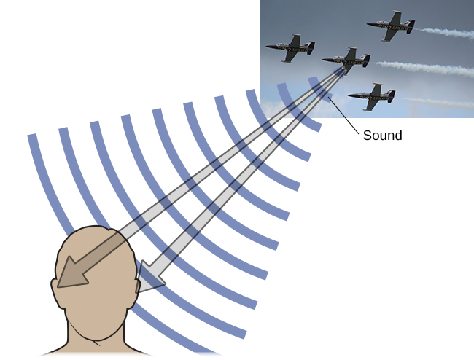
Localization of Sound: Vertically

Slide 33
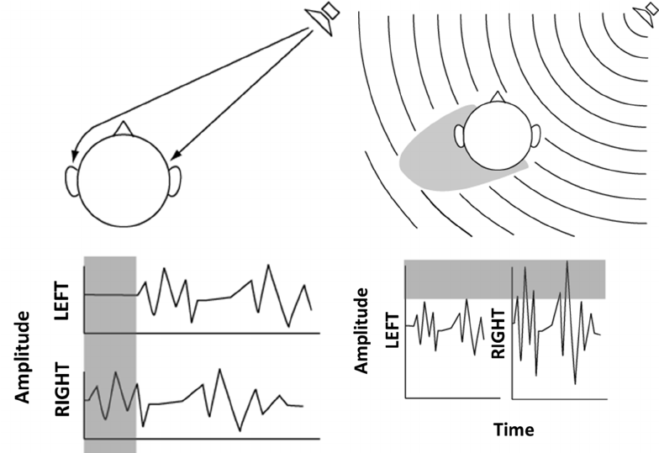
Localization of Sound: Horizontally

Slide 34
Questions?
Let’s start working on use-case 1!

Slide 35
Break
Take a walk of 5 minutes and meet me at the Innovation Square!
Be back in 20 minutes for the perception lecture!

